Slide 1
Serialization: Data Exchange & Storage Formats
System Design Fundamentals - Web Concepts

Slide 2
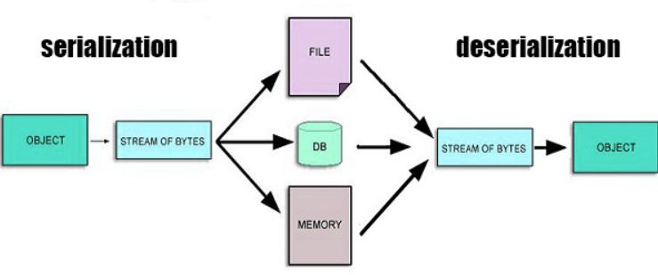
Why Serialization Matters?
Applications need to exchange & store structured data eﬃciently.
Serialization converts complex objects into a format that can be easily transferred.
Used in APIs, databases, caching, and distributed systems.

Slide 3
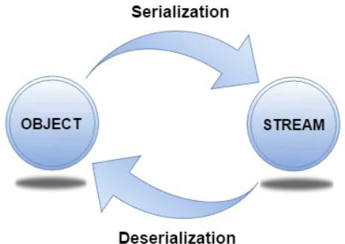
What is Serialization?
Serialization: Converting objects into a format for transmission/storage.
Deserialization: Converting it back into an object.
Essential for distributed systems & inter-process communication.

Slide 4
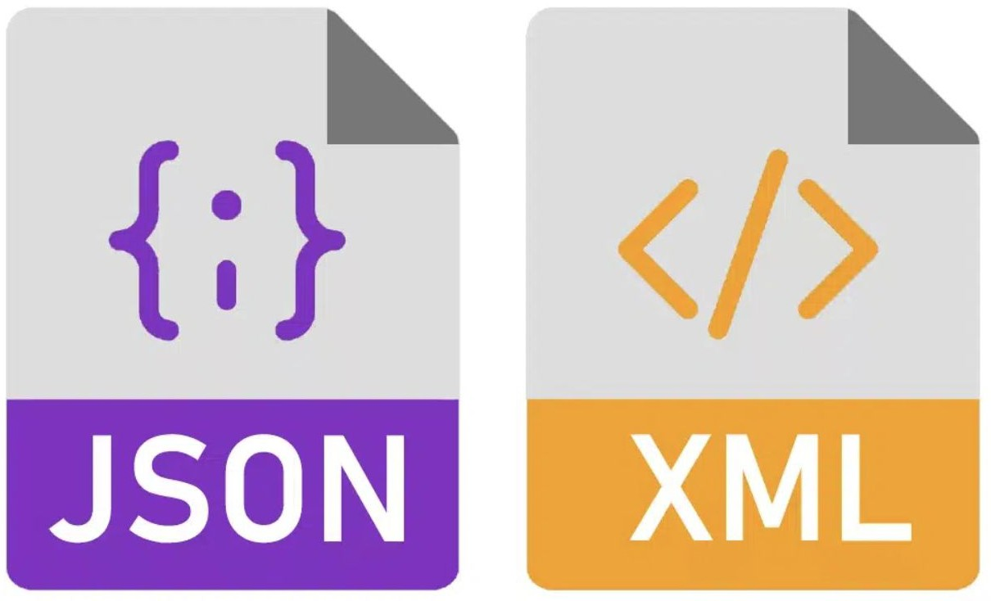

Common Serialization Formats
JSON – Human-readable, widely used in REST APIs.
  Human-readable, widely used in APIs & web applications.
  Simple key-value structure, easy to parse.
  Text-based, so larger in size compared to binary formats.
XML – Structured but verbose, used in legacy systems.
  Tag-based markup language, used in legacy systems & conﬁguration ﬁles.
  More complex than JSON, supports rich data structures.
  Verbose, leading to larger payloads.
Protocol Buﬀers (Protobuf) – Compact & eﬃcient, used in gRPC.
  Binary format developed by Google.
  Faster & smaller than JSON/XML, but requires schema deﬁnition.
  Used in gRPC for high-performance APIs.

Slide 5
Trade-offs: Readability vs. Efﬁciency vs. Compatibility
Readability: JSON & XML are human-readable, but ineﬃcient.
Eﬃciency: Protobuf & Avro are compact, reducing bandwidth usage.
Compatibility: XML support schema evolution, JSON has limited support.

Slide 6
Serialization in action
Serialization in APIs
  REST APIs mostly use JSON.
  gRPC APIs use Protobuf for eﬃciency.
  XML is still used in SOAP-based web services.
Serialization in Caching & Data Storage
  Redis & Memcached: Store serialized JSON/Protobuf data.
  Databases: NoSQL databases like MongoDB use BSON (Binary JSON).
  Big Data: Protobuf used for eﬃcient storage & schema evolution.

Slide 7
Performance Considerations
Serialization choice impacts Bandwidth, CPU, and Memory Usage.
JSON/XML → Larger payloads, slower parsing.
Protobuf → Smaller payloads, faster parsing but needs schema.

Slide 8

Important Interview Questions on Serialization
Understanding Serialization
  What is serialization, and why is it needed in system design?
  How does serialization impact data exchange and storage?
Comparing Serialization Formats
What are the key diﬀerences between JSON, XML, Protocol Buﬀers, and Avro? When would you choose Protobuf over JSON?
Serialization in APIs and Distributed Systems
How does serialization impact API performance and eﬃciency? Why is Protocol Buﬀers commonly used in gRPC instead of JSON?
How does serialization aﬀect caching strategies in systems like Redis?
Performance and Trade-oﬀs
What are the trade-oﬀs between readability, eﬃciency, and compatibility in serialization formats? How does serialization impact CPU and memory usage?
Real-World Applications
How is Avro beneﬁcial in big data systems?
Why do some databases like MongoDB use BSON instead of JSON?
Security Considerations
  What security risks are associated with serialization?
  How can improper deserialization lead to vulnerabilities?
●
○
○
●
○
○
○
●
○
○
●
○
○
●

Slide 9
Summary & Key Takeaways
Serialization enables eﬃcient data exchange & storage.
Choose the right format based on performance, readability, and compatibility.
JSON for APIs, Protobuf for eﬃciency, Avro for big data.
Impacts bandwidth, processing speed, and storage eﬃciency.
What’s next:
  CORS: Cross-Origin Resource Sharing & Web Security

